Slide 1
Enterprise-Scale landing zones Enterprise-scale for AKS
Speaker
Title

Slide 2
Agenda
1
2
3
4
5
6
7
Azure landing zones
What is "Enterprise-scale"?
Enterprise-scale design principles
Enterprise-scale design guidelines
Enterprise-scale implementation guide
Enterprise-scale reference implementations
Resources & next steps

Slide 3
Azure landing zones

Slide 4
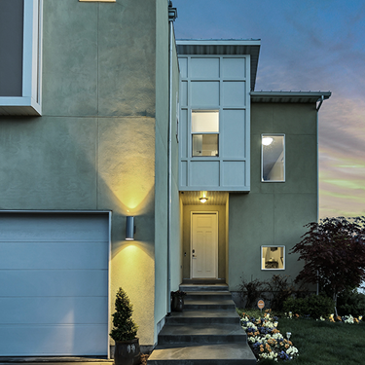
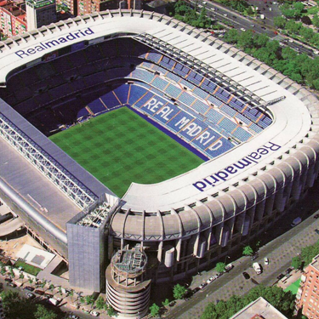

What structure are you going to build?
House
Stadium
Bridge
Notes:
When you are building a city, the process of deciding what you’re going to build will drive what foundation you choose.
Each of these buildings requires a different kind of foundation.
What foundation is the right one for what you are building?

Slide 5
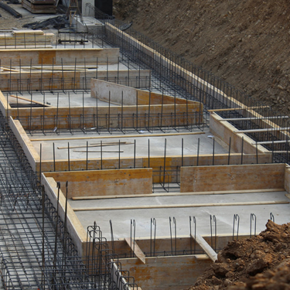
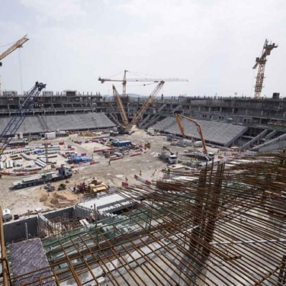
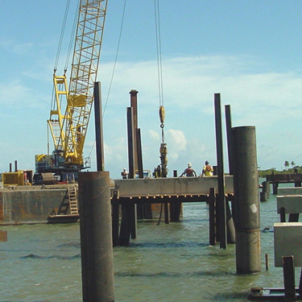
Not all foundations are created the same way
House
Stadium
Bridge
Notes:
Your choice foundation depends on what you’re going to build in the first place.
Foundations will be tailored to the construction of what’s being built above it.
Let's see how choosing the right structural foundation for a building is like choosing the right cloud foundation.

Slide 6




You create cloud business value— when you create a cloud-ready environment that is…
Agile
Aligned to business priorities
Adapted for cloud operating model
Ready for cloud applications
Adaptable for growth and expansion
Compliant with cloud-ready corporate policy
Aligned to cloud-design considerations
Continuously innovative
Secure
Notes:
Constructing a cloud-ready environment is like building a house structurally up to code.
If a customer wants to build an app in the cloud, we must build the environment that helps them deliver on their business priorities.
What is the cloud operating model that is running the application?
We must ensure that the environment scales as the application becomes more robust and more complex.
The cloud environment must be compliant.
Cloud-ready environments help customers to become agile, make use of innovative technologies, and remain secure.
Let’s look the ways that Azure landing zones can help customers.

Slide 7
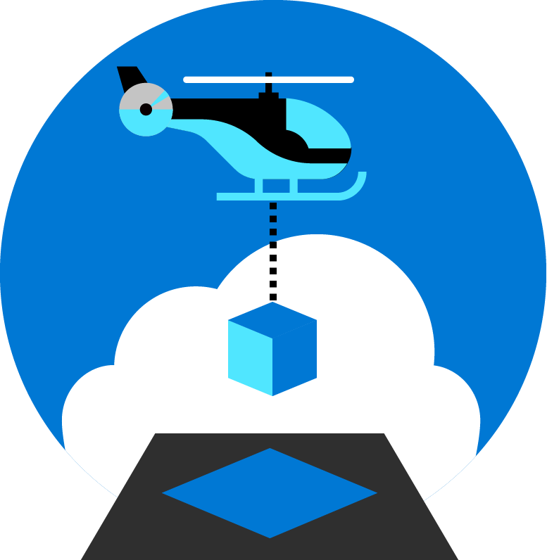
Azure landing zones help customers set up Azure environments with enterprise scale, security, governance, networking, and identity guardrails.
Enable migrations and net new apps
Consider all platform resources
Don't differentiate between IaaS or PaaS
Notes:
What are Azure landing zones and what do they enable customers to accomplish?
Azure landing zones support all paths to the cloud, (including migrations on-prem to the cloud) and building net new applications.
Let’s look at how Azure landing zones fit in with the Microsoft Cloud Adoption Framework.

Slide 8
Microsoft Cloud Adoption Framework for Azure Proven business and technical best practices guidance — guiding customers to create and implement business and technology strategies necessary for successful cloud adoption
Define strategy
Define business justification and expected outcomes
Plan
Align actionable cloud adoption plan to business outcomes
Ready
Prepare people, process and environment for change
Ready
Prepare people, process and environment for change
Adopt
Migrate or Innovate
Implement desired changes across IT and business processes
Govern
Comply, control and secure
Manage
Operate and optimize
Notes:
The Ready stage of the Microsoft Cloud Adoption Framework involves preparing organizations’ people, process and environment for digital transformation.
We want to enable customers to successfully adopt the Azure cloud.
When we’re talking about cloud adoption and landing zones, we’re pointing to the Ready stage.
In the Ready stage, cloud adoption plans have been discussed and defined, and we are ready to deploy a workload on Azure.
Let’s look at Azure landing zones in more detail.

Slide 9
Azure landing zones Design areas
Enterprise enrollment
Business continuity & disaster recovery
Identity
Governance disciplines
Resource organization
Deployment options
Network topology & connectivity
Operations baseline
Notes:
The critical components of Azure landing zones are the design areas.
Remember the foundation we’re choosing? And how it depends on what house we are building?
Foundations for house construction have common attributes but have their own specific components—and the cloud environment is similar.
These are the design components that all Azure landing zones must have.
Thinking about how to deploy and how to manage landing zones, Deployment options and Operations baseline are critical to the Manage stage.
Let’s look at how we get started with Azure landing zones.

Slide 10
How do we get started?
Platform development velocity
Cloud operating model
Notes:
There are two main components to Azure landing zones—Platform Development Velocity and the Cloud Operating Model.
Now we understand the design components in Azure landing zones. How do we get started? How do we get our customers started?
Platform Development Velocity is how fast the customer can, or wants, to develop necessary skills to efficiently manage their cloud platform.
The Cloud Operating Model is the operating model for the entire cloud environment, including landing zones and workloads planned for deployment.
How do we get started with implementing Platform Development Velocity?

Slide 11
How do we get started? Platform development velocity
Azure Landing Zones
Foundation blueprint
Iterative implementation
Migration blueprint
Terraform modules
Rich initial implementation
Enterprise-Scale Landing Zones
https://aka.ms/adopt/landingzone/cafmigrate
https://aka.ms/adopt/landingzone/caffoundation
https://aka.ms/adopt/landingzone/terraform
https://aka.ms/adopt/landingzone/enterprise-scale
Notes:
<Key point>: Platform Development Velocity can be implemented in two ways.
With iterative implementations, customers are more tentative, and more deliberate in learning process. They want to start small, grow, and learn as they grow.
With a rich initial implementation, customers are more mature. They are looking for a robust implementation from day one.
[Go through options for each implementation]
[Call out short links on CAF landing zone documentation and ARM templates for customers’ next steps (GitHub documentation).

Slide 12
What is "Enterprise-scale"?

Slide 13
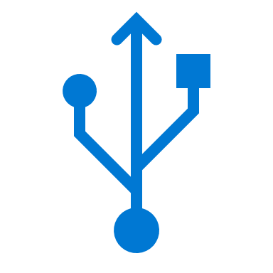
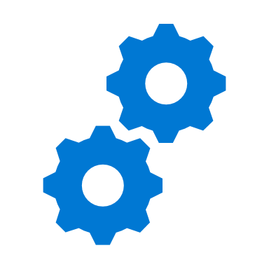
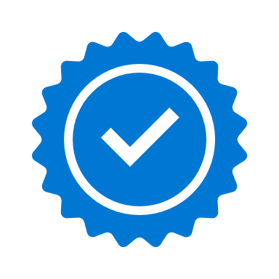
Key challenges
Architecture complexity
Customers lack required level of understanding and experience on Azure. Mismatch between on-premises infrastructure and cloud-design considerations creates dissonance and friction with respect to defining architectures and standards for their migration to the cloud. They are struggling with the translation of requirements to Azure concepts, capabilities, constructs and security model.
Operating compatibility
Existing approaches and functions for traditional delivery and management of IT services are not compatible with Azure platform and cloud operating models. When combined with lack of skills and experience, customers struggle to define and therefore transform their operating model to manage and support large-scale cloud infrastructure.
Lack of trust and desire for control
Absence of precise and detailed cloud architecture compliant with requirements, and lack of well-defined operating model to support such a platform, leads IT not to trust Azure and instead strive to maintain full control. This often involves building ‘walls’ and complicated processes which ultimately get in the way of business lines adopting Azure.
Notes:
We'll encounter three key challenges with landing zone implementations: architecture complexity, operating compatibility, and lack of trust and desire for control.
In working with our customers and partners we have received feedback from some of the challenges they face.
When starting with Azure (but being accustomed to traditional IT architecture), the cloud model can get lost in translation between Technology concepts, security models, and IT management processes.
On top of the architectural challenges there are challenges with operating models. Traditional delivery and management of IT services is not compatible with cloud operating models.
Lastly our Customers and partners have a desire for control of the environment and precise and compliant platform that generates trust.
How can you start thinking about landing zones—to understand what their function (and benefit) is for customers?

Slide 14
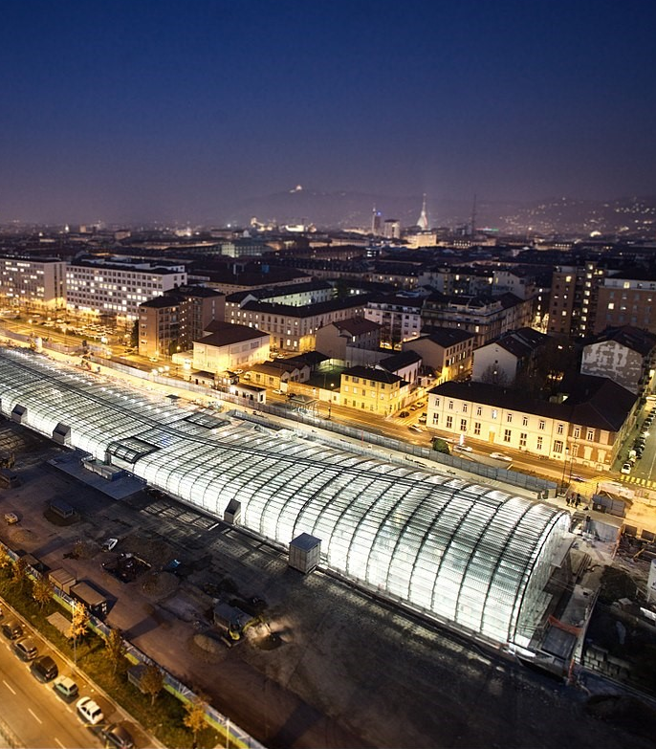
Guardrails— audit and enforce corporate standards and policies
City utilities must be running before your house is constructed
Network, IAM, policies, operations management, and monitoring are shared utility services that must be available as guardrails for the application migration process
Copyright © Michele D’Ottavio
Notes:
Building a landing zone, is like constructing a city by selecting the necessary services to serve as a foundation.
Before buildings can be erected and people move into them essentials services must be in place. Road are necessary for people to move around, water and sewer facilities need to be in place, power and gas lines must be made available. You can think of a landing zone as the essential services required for the different types of applications you will host on Azure. Different applications may require different services, and guardrails, and therefore will live in different landing zones. Similar to zoning codes in real life.
Major shift for centralized IT orgs in this scenario:
to move from providing all the infrastructure (building for people to live in) to providing the zoning guides (guardrails to be in place for other business units to build their infrastructure and applications upon).
One main cloud benefit is that you can scale resources based on demand and the there is practically no limit on scale. The same applies for scaling down. Just like you turn on light bulbs when you need it and turn it off when you do not , and you are charged only for the portion of electricity when the light bulb is turn on, you can turn on any VM, resources, IoT or any other resources when you need it and turn it off when you do not . Azure give you better option than turn on and off button, imagine a dial on light bulb and keep adjusting for the light needed indoor during daytime or night when light keep changing because of sunlight or cloud. There is practically no capital cost associated with IT in the cloud because you are not buying hardware to build a datacenter. You are using resources on demand, based on your need.
Because of this power of unlimited scale, governance problem arises. Due to sheer number of resources, governance and organization of resources turn into a challenge. Imagine a library with a pile of books with no marking and sorting and section—it'd be hard to find the book you want. The same applies to resources in Azure subscriptions if it's not organized for operational efficiency.
Enterprise scale is the answer to organizing subscription to landing zone. We build landing zone so we would know where to go and provision resources when we need them. Just like in a library when we pick up a book, we know where to go to find it or to place it.
Landing zones help with the adoption of cloud and give you a better way of organizing resources not just by type, but organization, cost and security.
Let's examine "Enterprise-scale" is—and how it can benefit your organization's cloud journey.

Slide 15
What is "Enterprise-scale"?
"Enterprise-scale" is an architecture approach and reference implementation that enables effective construction and operationalization of landing zones on Azure, at scale and aligned with Azure Roadmap and Microsoft Cloud Adoption Framework for Azure
Authoritative Framework for holistic design decisions on Azure
Proven
Based on customer experiences with large-scale Azure migration projects at-scale
Prescriptive Apply standards to clearly plan and design Azure environments
Enterprise-scale architecture
Enterprise-scale reference implementation
Enterprise-scale design principles: Principles that provide guidance to customize design areas
Enterprise-scale design guidelines: Guidelines (decisions and recommendations) for the 8 components of enterprise-scale architecture
Enterprise-scale implementation guide: How to implement enterprise-scale architecture components using reference implementations in GitHub and the deployment pipeline
Enterprise-scale foundation: Reference implementation of shared (network, security, identity, and governance) services— required to construct and operationalize an enterprise-scale landing zone
Enterprise-scale landing zones: Reference implementation of a workload environment—aligned to enterprise-scale architecture (declarative way of implementing code)
Notes:
Enterprise-scale comes in two buckets, architecture and reference implementation.
Architecture—guidelines that are based on real-world work with our strategic customers.
Reference implementation—first partner example on how this could be implemented.
You do not have to use this reference implementation if you are following the design guidelines and principles. In the rest of the session, we’ll discuss these 5 elements.
Let's look at the different parts of Enterprise-scale in more detail.

Slide 16
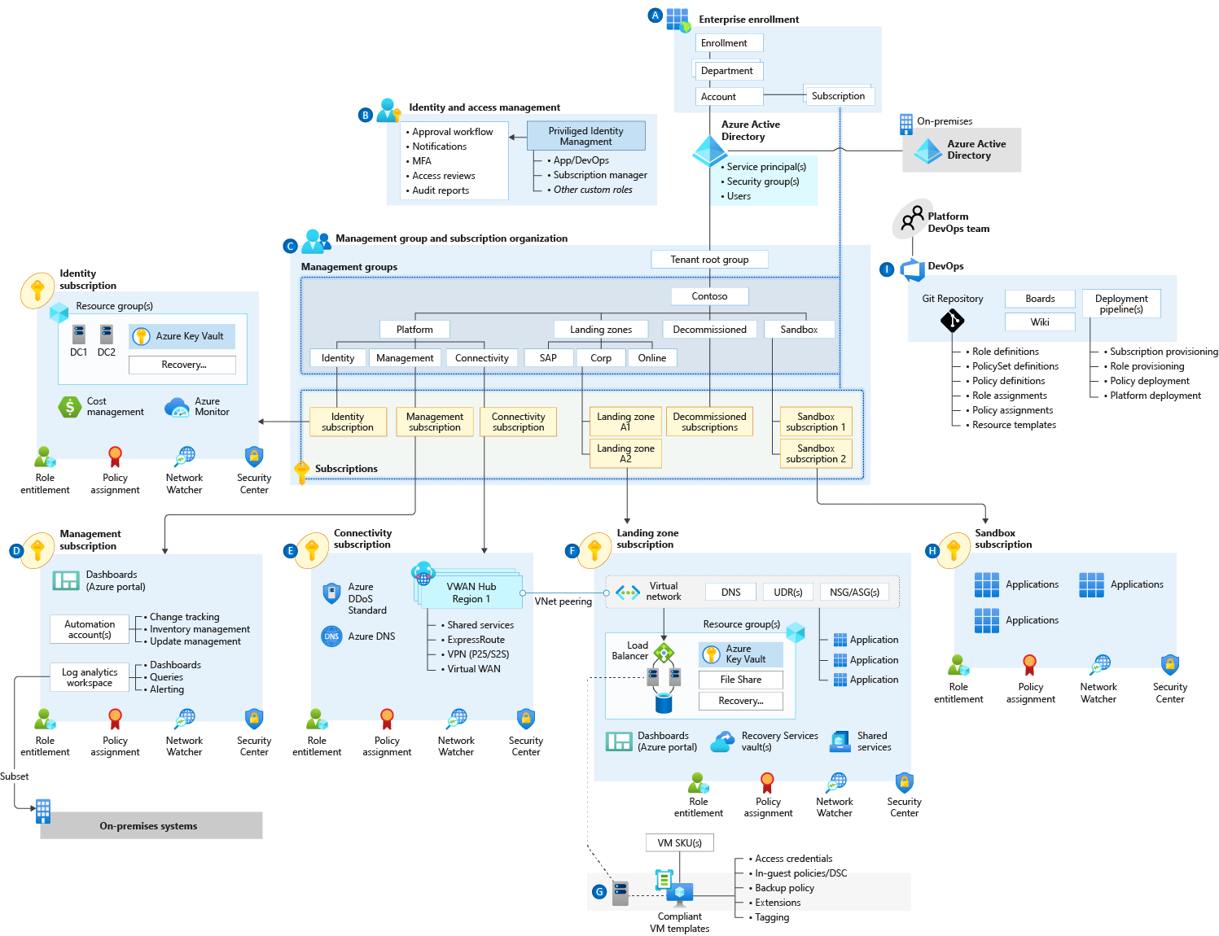
"Enterprise-scale"
Notes:
"Enterprise-scale" is an architecture approach and reference implementation that enables effective construction and operationalization of landing zones on Azure, at scale and aligned with the Azure roadmap and the Microsoft Cloud Adoption Framework for Azure.
The enterprise-scale architecture provides prescriptive guidance coupled with Azure best practices, and it follows design principles across the critical design areas for the customer's Azure environment.
Let's look at what the Enterprise-scale landing zone can provide for customers.

Slide 17
Enterprise-scale landing zone
Helps customers set up Azure environments with enterprise scale, security, governance, networking, and identity guardrails.
Notes:
The CAF enterprise-scale landing zone architecture represents the strategic design path and target technical state for the customer's Azure environment.
It will continue to evolve in lockstep with the Azure platform and is ultimately defined by the various design decisions the customer organization must make along their Azure journey.
Let's take a look at what a "workload-specific ESLZ" is.

Slide 18
What's a workload-specific ESLZ?
Solution and scenario-specific landing zone
Focuses on the workload—AppOps
Has its own design considerations and recommendations
Has its own reference implementation
1
BUILD ON ENTERPRISE-SCALE
20% Internal IT
2
PROVIDE PRESCRIPTIVE GUIDANCE
30% Enterprise-scale for AKS
SPECIALIZATION
3
50% Enterprise-scale landing zone
DEFINE PLATFORMops & APPops
Notes:
This workload-specific ESLZ is an ESLZ that's focused on AKS.
This ESLZ comprises:
Solution and scenario-specific Landing Zone
Focuses on the workload - AppOps
Has its own design considerations and recommendations
Has its own reference implementation
Let's look at "Enterprise-scale" for AKS—and how it can benefit your organization's cloud journey.

Slide 19
What is Enterprise-scale for AKS?
Enterprise-scale for AKS is an architectural approach and reference implementation that—
enables effective workload and scenario operationalization of landing zones on Azure, at scale and aligned with Azure Roadmap and Microsoft Cloud Adoption Framework for Azure
Authoritative Framework for holistic design decisions on Azure
Proven
Based on customer experiences with large-scale Azure migration projects at-scale
Prescriptive Apply standards to clearly plan and design Azure environments
Enterprise-scale for AKS architecture
Enterprise-scale for AKS reference implementation
Construction set design guidelines
Guidelines (decisions and recommendations) for the 6 components of enterprise-scale architecture
Reference implementation of shared (network, security, identity, and governance) services—required to construct and operationalize an enterprise-scale landing zone
Notes:
Enterprise-scale comes in two buckets, architecture and reference implementation.
Architecture—guidelines that are based on real-world work with our strategic customers.
Reference implementation—first partner example on how this could be implemented. You do not have to use this reference implementation if you are following the design guidelines and principles. In the rest of the session, we’ll discuss these 5 elements.
Let's move on, and take a look at the Enterprise-scale AKS conceptual reference architecture.

Slide 20
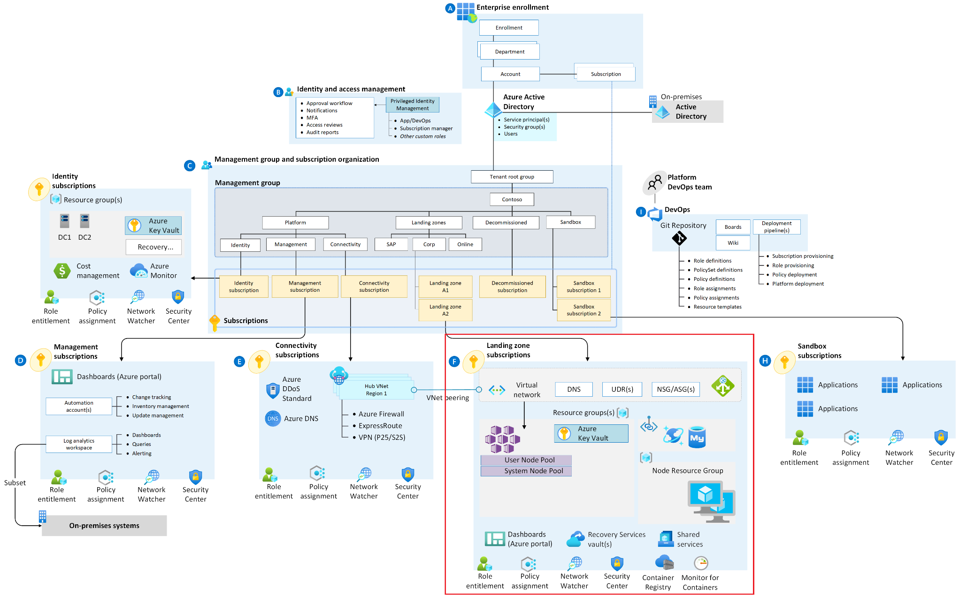
Enterprise-scale for AKS
Notes:
Enterprise-scale for AKS = strategic design path and target technical state for an Azure Kubernetes Service (AKS) deployment.
Enterprise-scale construction sets = architectural approach and reference implementation.
They enable effective workload and scenario specific operationalization of landing zones on Azure—at scale and aligned with the Azure roadmap and the Microsoft Cloud Adoption Framework for Azure.
The enterprise-scale architecture provides prescriptive guidance coupled with Azure best practices, and it follows design principles across the critical design areas for the customer's Azure environment.
In what situations would you deploy Enterprise-scale for AKS?

Slide 21
When to use Enterprise-scale for AKS
Layered architecture based on scope of efforts
Each of these layers are built with loose coupling e.g., GitHub Accelerators will work with AKS clusters deployed through Enterprise-scale for AKS or otherwise. Similarly, Enterprise-scale for AKS can be deployed in ESLZ based core platform foundation or any other foundation etc.
Layer | Purpose | Persona | Assumption / Dependency
GitHub Accelerators | Deploy your application code using GitHub repository for samples and GitHub Actions for deployment | Application Developers (Inside the individual business units) | Core Application Infrastructure is already available by App Infrastructure team e.g. AKS Clusters through AKS Construction Set
Enterprise-scale for AKS | Deploy AKS specific policies & AKS cluster | App/Dev Ops Team (Providing Infrastructure Hosting abstraction) | Core Azure Platform foundation is already available from Platform Ops team e.g. by deploying ESLZ
ESLZ | Core Platform Foundations | Central Cloud Team (IT) | None
To do:
Add AKS Baseline
Update construction set requirements based on latest thinking
Notes:
Enterprise-scale for AKS is an open-source solution with a layered architecture that is adaptable.
The enterprise-scale approach for AKS provides these assets to support your project:
Modular approach, so that you can customize environment variables.
Design guidelines to aid in evaluating critical decisions.
The landing zone architecture
A Microsoft-recommended AKS reference implementation based on the AKS secure baseline.
Now, let's look at the critical design areas for Enterprise-scale for AKS.

Slide 22
Construction set: design guidelines

Slide 23
Design areas Enterprise-scale for AKS
Identity & access management
Network topology & connectivity
Operations management
Business continuity & disaster recovery
Security governance
Deployment options
Notes:
There are (6) critical design areas for Enterprise-scale for AKS.
The design areas translate customer requirements to Microsoft Azure constructs and capabilities and address the mismatch between on-premises and cloud-design infrastructure, which typically creates friction between the enterprise-scale definition and successful Azure adoption.
The impact of decisions made within these critical areas will reverberate across enterprise-scale architecture and influence other decisions.
Readers should familiarize themselves with the eight areas below to better understand the consequences of encompassed decisions, which may later produce trade-offs within related areas.
Let's look at the design considerations for Identity & Access Management.

Slide 24
Identity & access management
Planning for authentication inside the landing zone
Design considerations
Decide what cluster identity is being used (managed identity or service principal)
Decide on how to authenticate cluster access (cert-based or Azure AD)
Design recommendations: cluster identities
Use your own managed identity for your AKS cluster
Define custom Azure RBAC role for AKS landing zone to simplify management of required permissions for cluster-managed identity
Notes:
Review the main points of the slide, to support the main idea (highlighted in blue).
Let's look at the design considerations for network topology and connectivity.

Slide 25
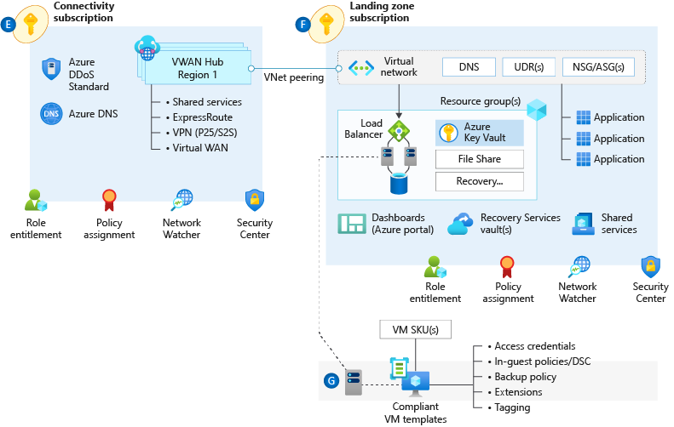
Network topology & connectivity
Design considerations
Decide on cluster IP visibility, whether it should have a public or a private IP address
Plan the IP addressing and the size of the VNet subnet, to support the scaling of the cluster by adding more nodes, etc.
Design recommendations
If your security policy mandates having the Kubernetes API with a private IP address (instead of a public IP address), deploy a private AKS cluster
Use Azure Container Networking Interface (CNI) as network model, unless you have a limited range of IP addresses that can be assigned to the AKS cluster
Planning for IP addressing & size of the virtual network subnet
Notes:
Review the main points of the slide, to support the main idea (highlighted in blue).
Let's look at the design considerations for operations management.

Slide 26
Operations management
Design considerations
Be aware of ways to isolate workloads logically within a cluster and physically in separate clusters
Be aware of ways to control resource consumption by workloads
Understand AKS limits:
Quotas and regional limits
AKS service limits
Use logical isolation at the namespace level to separate applications, teams, environments, business units: Multi-tenancy and cluster isolation. Also, node pools can help at nodes with different node specifications, and maintenance like Kubernetes upgrades: Multiple node pools.
Planning for platform & application management and monitoring
Notes:
Review the main points of the slide, to support the main idea (highlighted in blue).
Let's look at the design considerations for Business Continuity & Disaster Recovery (BCDR).

Slide 27
Business continuity & disaster recovery
Planning for BCDR
AKS Cluster nodes should use multiple nodes in a node pool to provide the minimum level of availability for your application
Set pod requests and limits. Setting these limits allows Kubernetes to efficiently allocate CPU and, or memory resources to the pods and have higher container density on a node. Limits can also increase reliability with reduced costs because of better hardware utilization.
Notes:
Review the main points of the slide, to support the main idea (highlighted in blue).
Let's look at the design considerations for security governance.

Slide 28
Security governance
Planning encryption & key management
Design considerations
Decide whether the cluster's control plane is accessible via the internet (default) or within a specific VNet only (private cluster)
Monitor and enforce configuration using Azure Policy for Kubernetes
Design recommendations
Limit access to Kubernetes cluster configuration file with Azure role-based access control
Limit access to actions that containers can perform. Provide the least number of permissions and avoid the use of root/privileged escalation.
Notes:
Review the main points of the slide, to support the main idea (highlighted in blue).
Let's look at the design considerations for deployment options.

Slide 29
Deployment options
Planning for a DevOps Approach
Design considerations
Consider the Azure service limitations and your CI/CD environment, which will determine the approach to take for engineering and automating your solution. For another example, see the GitHub usage limitations.
Consider the various security options in securing and protecting access to the various environments (development, test, Q&A, production etc.) from an CI/CD perspective. As deployments will happen automatically, access control should be mapped accordingly.
Notes:
In Azure, everything is a resource. Management of the resources provisioning should be repeatable, consistent and versioned
The image highlights the functional roles and responsibilities of a Platform DevOps Team.
Resources & Policies are deployed through ARM and centrally stored in the GIT repository seen on the left.
The right side is the automated provisioning, deployment, orchestration and lifecycles of the subscription, roles and policies.
Both together will enable teams to deploy and manage infrastructure through automation
Delineation between DevOps vs AppOps
DevOps – Application team is responsible for managing the full lifecycle of the resources created
AppOps – Some customers don't have not adopted devops and have a dedicated, centralized team to support IT operations on their behalf (E.G Backup, Tuning, Provisioning)
Identify and Access Management
DevOps/App Ops group with Contributor role assigned at RSG level
Who is the audience for the Enterprise-scale for AKS workshops?

Slide 30
Enterprise-scale for AKS
Audience
Arch Lead / Chief Architect
Identity and access management (IAM)
Network (NetOps)
Systems (SysOps: OS, DB)
Operations and management
Security (SecOps)
DevOps and automation
Application architecture
You may bring additional SMEs where and when required
Notes:
This is the target audience for Enterprise-scale for AKS.
Highlight that additional SMES are welcome to attend the workshop, if needed.
Let's talk about what the next steps will look like.

Slide 31
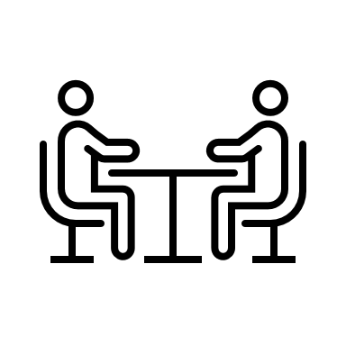

Next steps Set up workshop dates and attendees for Enterprise-Scale for AKS
Review
Deep understanding of your environment, workloads, and technical constraints
Design
Target Landing Zone architecture is designed that is aligned with Enterprise-scale and in compliance with your requirements
Success Criteria
All technical requirements to build a ESLZ on Azure are understood and captured.
Success Criteria
Target ESLZ architecture design agreed and documented.
https://aka.ms/aksconstruction-set
Notes:
Here are the next steps—
After presenting the overall concept of the ESLZ and the AKS specific landing zones, set up a date and confirm attendee prospects interesting in attending the review workshop.
The review workshop is where CSA works with customers to understand their current environment, workloads, technical constraints, etc, to understand how that would translate to an enterprise scale implementation.
Communicate to customers that after completing the review workshops, the CSA will run another set of workshops to design the target landing zone architecture.
Thank you!

Slide 32
Thank you!

